Slide 1
Enabling Silverlight Content in Safari
Mac TEIS

Slide 2
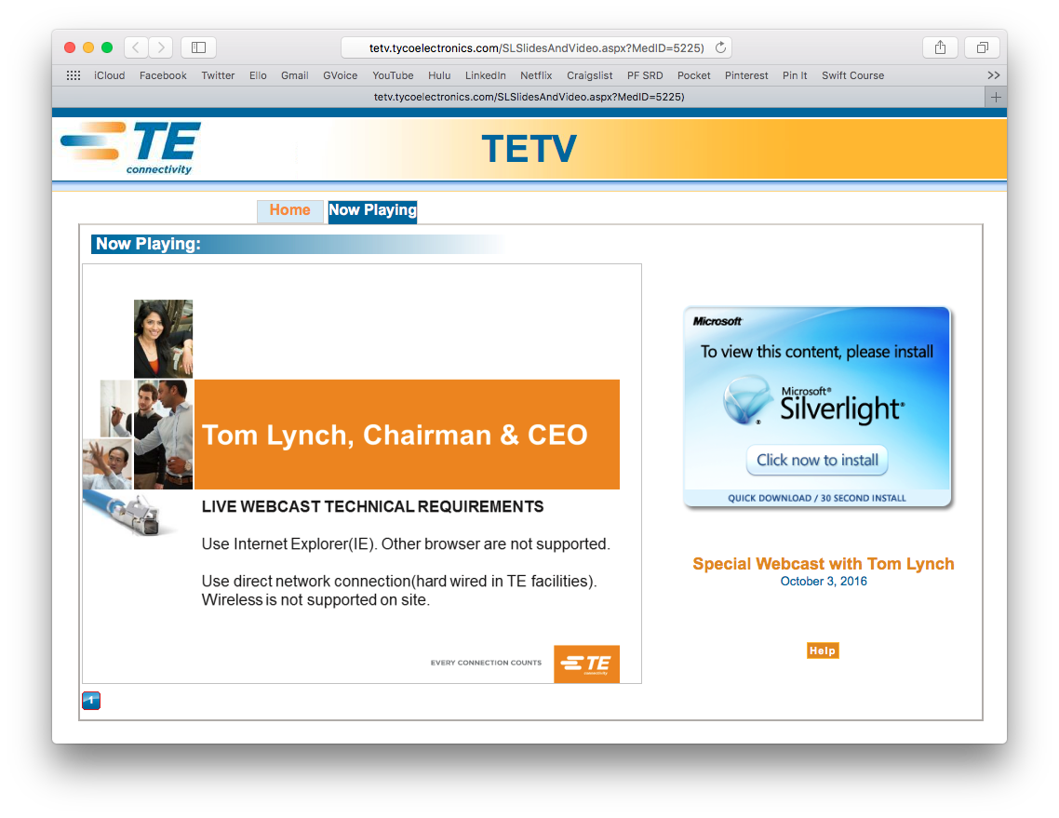
Issue: Safari does not play Silverlight content.
When attempting to access TETV content, such as the internal WebCast, recent version does not display the video content, behaving as if Silverlight is not installed.
This is potentially caused by a security feature added to Safari, that prevents websites from automatically initializing plugins capable of executing possibly malicious code. You will need to either manually enable these plugins each time you want to use them, or trust certain sites/domains to allow them to automatically access the plugins.

Slide 3
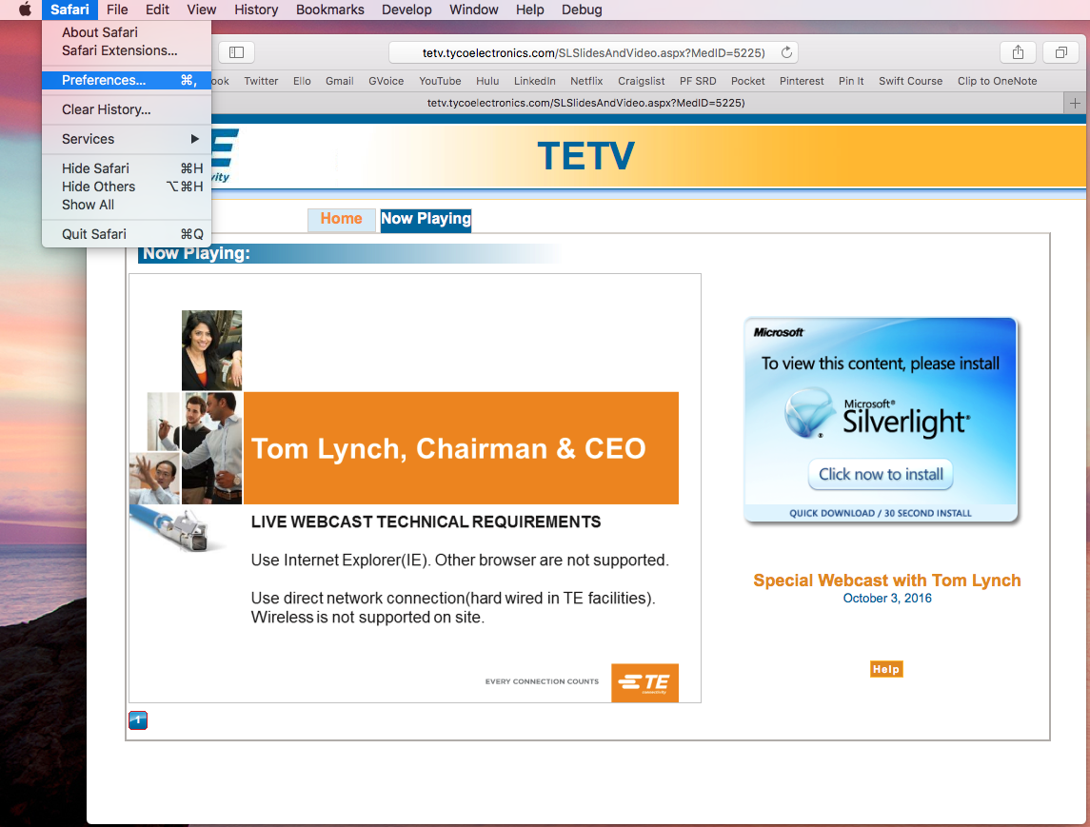
Open Safari Preferences
From the Safari menu in the upper left of your screen, select the Preferences option.

Slide 4
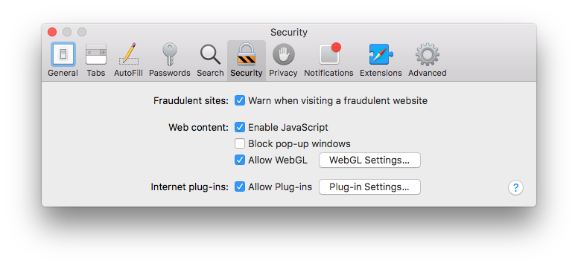
Select the Security tab
From the options across the top of the Preferences screen, select the Security choice.
Towards the bottom of that pane, make sure the “Allow Plug-Ins” checkbox is check.
Click the ”Plug-In Settings” button to display more information about individual plug-ins.

Slide 5
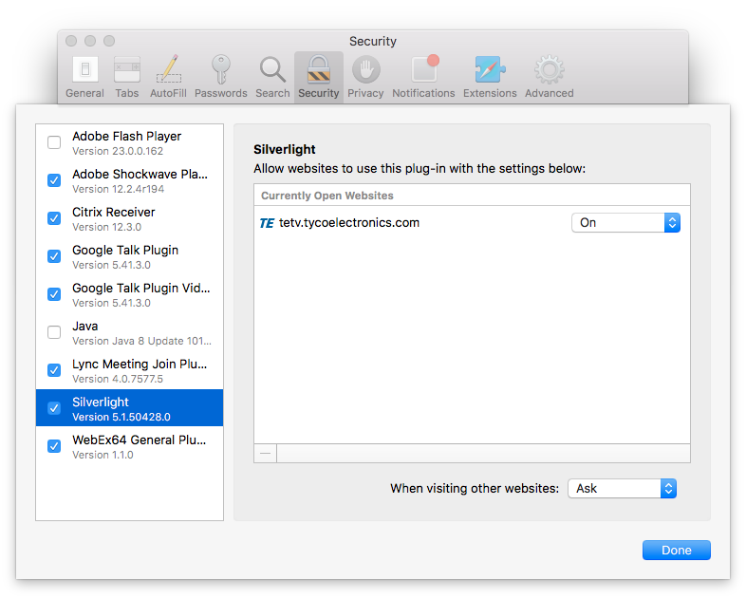
Activate & Configure Silverlight
If you do not see Silverlight in the list on the left, you need to reinstall it.
If Silverlight is present, check the checkbox to activate the plug-in.
With Silverlight selected, the panel on the right will list the sites you have visited that use the plug-in
Using the dropdown list, set any TE sites, including TETV to “On”.
Optionally, use the “When visiting other websites” dropdown in the lower right to set the default behavior for other sites that use this plug-in.
Click the “Done” button to apply these settings.

Slide 6
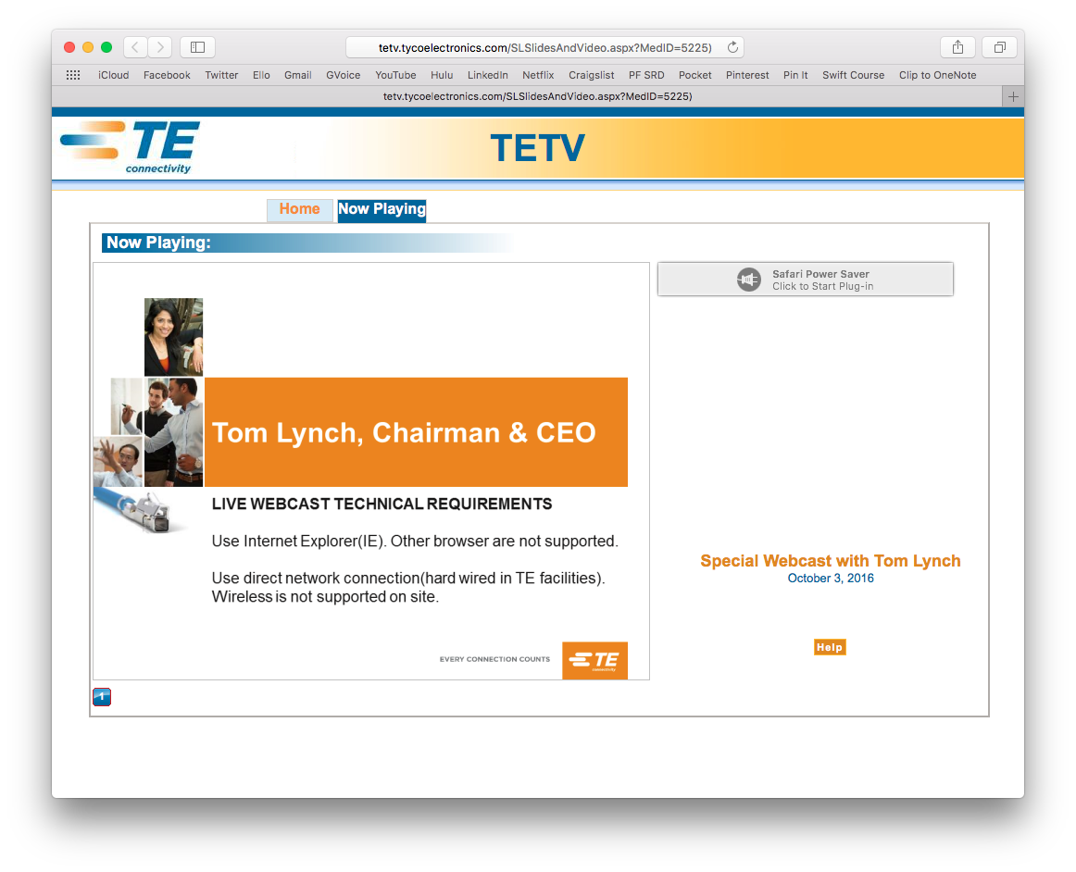
Power Saver
Once the plug-in has been enabled, it still may not be active by default. This is due to a seporate Safari feature that attempts to power down plug-ins in an effort to reduce CPU usage and save battery life.
You should now have grey bar with a power plug icon that you can click on to activate the plugin and display your content.

Slide 7
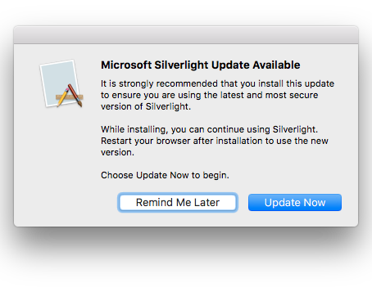
Update Prompt
Once powered on, many plug-ins, including Silverlight, will automatically check for updates. It is important to keep these components updated, as it not only ensures compatibility with content, but it also applies essential security fixes to patch potentially exploitable vulnerabilities.

